Slide 1

Aparna Venugopal
#66291
Functional Overview
Universal Banking Solution from Infosys

Slide 2
Agenda
Overview of Finacle CRM,
Various functionalities provided by Finacle CRM
Different modules available in Finacle CRM.

Slide 3
Finacle CRM Landscape
Finacle CRM Landscape
Transformation of banks from traditional approach
From account-centric to being customer oriented.
Finacle CRM (Customer Relationship Management) enables banks to transform to a customer-centric view of performance by consolidating customer information across all lines of business
Finacle CRM solution is a “Universal Banking Solution” that provides an end-to-end functionality addressing all the needs of the Bank right from marketing to sales and support of the customer

Slide 4
Finacle CRM Functional Architecture
Improving productivity of the staff is another thrust area of banks- Automation of various processes
These can be achieved by Automation of various processing activities ,Simplified process for deployment and usage by setting up appropriate processes to be followed for application processing (loan, credit cards) and service requests (address change, cheque book requests etc), Automatic escalation to the concerned managers(as a tracking tool) in case of delays encountered in closure of assigned tasks

Slide 5
Finacle CRM Functional Architecture
Of interfacing with the multiple backend systems like core banking, credit card systems, mutual funds etc., The application should also provide facility for accessing the applications through multiple channels like Call Centre, IVR, Internet banking, mobile banking, Point of Sale, branch etc., The application should be a secured one with role based access privileges. Integration with various backend system helps in achieving a Unified customer view in CRM for relationship maintained by the Customers across multiple backend systems.

Slide 6
Finacle CRM Functional Architecture
The Finacle CRM application supports all the functionalities. In a broader perspective the functional details of the Finacle CRM application can be understood through the following segregated topics
Channels,
Channel Integrator,
Interaction Management,
Functional modules,
Standard Components, and
Infrastructural Components

Slide 7
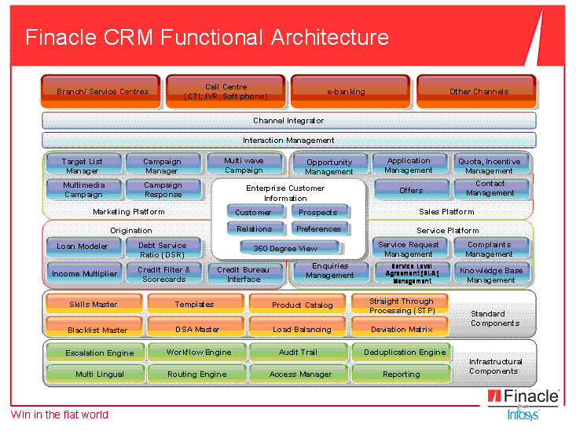
Finacle CRM Functional Architecture:

Slide 8
Channels
Channel is “the medium of communication with which the banks interact with the customer”.
Finacle CRM has the capability to support the various channels which would be installed in a typical Bank
Branch
Telephone
Internet
ATM
and many more such channels
Notes:
A customer might contact the branch of a bank to open an account or might contact the call centre to note a change in his address or might use his internet banking to lodge a cheque book request or might fax a bank his changed address. Banks consider the branch, telephone and internet as a “channel” of communication with the customer.

Slide 9
Channels
Banks marketing/ campaign, sells and services its products through all these channels. Finacle CRM helps banks retain its customers by providing an efficient system to serve its customers better and interacts with all the channels through the channel integrator
Branch Users would use Finacle Application as the front end when they are servicing or selling to a customer
Call Centre Users again would use Finacle Application as the front end when they are servicing or selling to a customer

Slide 10
Channels
The information a customer sees when he logs into internet banking on his profile/ the account details are fetched from CRM Application
In actual implementations, there may be many other such channels through which Bank would sell/ service the customer. Finacle CRM can integrate with such channels to ensure that across channels the kind of information shared about the customer and his accounts are same.

Slide 11
Channel Integrator
Finacle Integrator (as the channel integrator is called) is the common gateway of information access form Finacle Suite of products, including FinacleCRM. It is through this channel integrator that Finacle CRM accesses different system like the Core Online System, Credit Card System and Mutual Fund System
Banks interact with all the other channels/ applications through the Channel Integrator
Reduce the manual effort involved in getting information from a different system and the process time taken for a simple request like account balance
Notes:
When a call centre representative inquires about the mutual fund details of a customer, Finacle CRM sends an information to the Channel Integrator which contacts the corresponding backend system(in this case Mutual Fund System). The Channel Integrator gets the information from the corresponding system and replays it back to Finacle CRM.

Slide 12
Channel Integrator
Neutral to various backend systems, thereby reducing the need of modifying CRM each time a new product system is introduced. It is this layer that would “glue” the CRM system with the various channels/ product systems.

Slide 13
Interaction Management:
Any communication between the customer and the bank is an interaction between them.
These interactions may originate, continue and culminate on a particular channel. Or, they may originate on one channel, continue over other channels and culminate on a different channel
Some examples for interactions are request over telephone for a change in address, request for the details on the last 10 transactions through internet or request for bank statement through email

Slide 14
Interaction Management:
Sometimes the customer might call the bank for the same issue either to find out the status of the request he had placed or to provide some information to the bank regarding the request he had placed with the bank. Banks log these as “messages”.
Eg: : Let us consider a scenario where the customer has sent an email to the bank. This is considered as an “Interaction” by the bank. Any subsequent communication the bank has with the customer regarding the email he customer has sent, it is considered as a message by the bank

Slide 15
Interaction Management
A bank might have many messages for a single interaction
Interaction Management is the function of threading or associating all pieces of communication that deal with the same subject/issue/topic, irrespective of: channel of origin, direction (inbound or outbound), so that the bank can trace at any point in time every single message that it has exchanged with a stakeholder. Additionally, it is also the functionality of ensuring that if multiple issues/topics were raised in the initial Interaction, they are all resolved before the Interaction can be deemed resolved

Slide 16
Functional Modules
Customer Information File
Marketing
Sales
Loan Origination
Support
Standard & Infrastructural Components

Slide 17
Customer Information File
CIF (Customer Information File) module of F-CRM deals in maintaining Customer Information
Provides segregation of Retail and Corporate types of entities.
Overall and in-depth details about its customers and entities with which it deal in during its day to day business. Significant details like personal, identification, address, employment, demographic, financial, preferences etc. of not only customers but entities which are not yet customers and are in process of being prospective customers, casual banking service consumers etc

Slide 18
Customer Information File
Capturing and logically maintaining(including modifications & approvals of CIF records) varied information, be it regulatory requirements, or bank’s requirements for data or data which can be used by bank for marketing analysis, preferences analysis, profile analysis.

Slide 19
Customer Information File:
Customer: An entity who has an established relationship with the bank. An entity that has an account in the bank is considered a customer.
Prospect: An entity with whom the bank is trying to establish a relationship thro’ offering of its products/services.
Non Customer: Walk in entities who requests for some services without having an account with the bank.
Contact: The contact may be a reference or associated entity for operating the accounts of the customer.
Notes:
Notes: Show the details in CRM screen

Slide 20
Customer Information File:
Banks capture high volume of customer information and in all cases it may not be practical to obtain all information and feed into system right at the time of creation record itself. To cater such situations, Customer/Prospect/Contact records can be created with limited minimum set of information through Quick Data Entry (QDE)

Slide 21
Customer Information File
As part of regulatory requirements or banks’ internal policy to reduce risk of doing business with wrong profile of customers, banks need to blacklist, negative list or suspend customers. Such action would mean the type of transactions, if any, allowed to these types of customers would be restricted
Further, it’s usual practice of maintain information of related entities/persons. In case of the relationships like Guarantor, Introducer etc., this would help Bankers to reduce the risk on specific business interactions with the customers

Slide 22
Customer Information File
The maintaining of relationships also helps bank in better serving customers and track the records of the group entities, in case of relationships being amongst family. This is achieved in CIF module through maintaining house hold details of retail entities grouping entities belonging to same family under one ID. Similar concept is for corporate entities where group and group id is maintained for corporate entities of same group.

Slide 23
Customer Information File:
Standard practices in Banks’ internal control systems involve four eyes concept. That is, work done by one person should be reviewed/approved by other person. This concept of maker – checker is supported by CIF module wherein record created by one user is checked/approved by other user.

Slide 24
Marketing
Marketing is an integral part of bank’s selling and awareness programs. For launching its new products, making customer aware of its existing products, and approaching potential customers for selling its products; banks do campaigning, make offers which suits customer needs and maximize bank’s revenues.
Marketing module of F-CRM provides feature to create campaigns for products, define the marketing documents/brochures to be shared with customer during campaigning, channels to be used for contacting customers, list of potential customers to be contacted.

Slide 25
Marketing
It is necessary to target correct market segment and constituents thereof. This is done through Target List management.
Thousands of customers are contacted by bank and are communicated/informed about products, offers etc. Such numerous customers should be systematically and logically distributed amongst various call center employees or selling agents.

Slide 26
Marketing
Marketing module provides features for assigning and transferring targeted customers amongst bank employees, group of employees and selling agents.
When contacted customers respond differently and based on responses further action needs to be taken.
For customers showing interest is sought for selling the product and an opportunity is created in the application.
For customers not interested the records need to be updated for not contacting further.

Slide 27
Marketing
Macro management as well as micro management is achieved. Each individual response or preference is tracked.
Done by tagging individual records with work items
Frequent updates of new products coming, new services launched, initiatives taken, customer satisfactions, survey results etc.
Sending periodical newsletters besides one time campaigning of products.

Slide 28
Sales:
‘Banking’ from its very beginning had been accepting deposits from those having surplus funds and lending the funds to those needing funds
This comes under the Sales module
Any selling of product is looked in as an opportunity by bank for selling products
Capturing of opportunity for a product with varied information like CIFID for which opportunity is created, Product, Currency of product etc. is done under Sales

Slide 29
Sales
Selling of banking products like home loans, mortgaged loans etc. involves numerous checks, approvals, analysis, obtaining reports from external world, documentations and many more. Banks have preset standard process in processing such applications which needs to be followed uniformly across organization.
Notes:
Refer word

Slide 30
Loan Origination
The entire cycle beginning from the customer approaching the bank for loan till sanctioning of loan and opening account for disbursement is termed as Origination
The Loan origination module of F-CRM(in conjunction with Sales module) facilitates creation of loan applications from opportunities, filtering the customers, computing eligibility for loan, amount for which customer is eligible, obtaining credit bureau details, banks’ internal scores for application, verification of documents, credit decision, sanctioning and many more.

Slide 31
Loan Origination
Sequential standardized processes
Setting up these processes
Interfacing with external systems for documents verifications and credit bureau reports
It supports tools for computation of amortization schedule and payment planners.
Routing and escalations of process steps is supported and all features of Sales module are inherited.

Slide 32
Support
Various requests can be raised like cheque book requests, fund transfer, card lost etc.
Each request has got its own characteristics and its own set of details required for serving customers
The requests can be logged through various channels
Support module of F-CRM provides platform for configuring various types of service requests, capture details of service requests, process requests(automated, semi-automated and manual)

Slide 33
Support
There are various processes attached for completing one request
Since processing may undergo numerous steps and each step need not be executed by one person; based on skills or authority or load of users, service requests needs to be routed/assigned/transferred/escalated to appropriate users. This is done through support module
During processing of a service request, at times it becomes necessary for performing miscellaneous activities before logical closure of request
Notes:
Example: For dispatch of cheque book, delivery to courier desk may be one of the tasks to be completed. Delivery cheque book cannot be completed by call center user taking request and task can be assigned to some delivery boy.

Slide 34
Standard & Infrastructural Components
Two other important aspects in the overall scheme of things within the CRM Application are
The standard components
The Infrastructural components

Slide 35
Standard & Infrastructural Components
Standard components include Master setups and key configurations which would ensure the functionalities’ work. Ex: Blacklist Master is a standard component, which is required for the Blacklist check to be performed during customer creation, edit or as an adhoc action. Similarly Deviation Matrix is a setup which is required to be setup. This is attached to a process step to capture the logic of the approvals required, in case of the standard processing conditions are not met in a loan application.

Slide 36
Standard & Infrastructural Components
The infrastructural components include the technical backbone of multiple functionalities. Ex: Routing Engine ensures that the Routing functionality works on the basis of the routing matrix defined. Escalation Engine, Process Engine are few other similar components

Slide 37
Thank You!

